Slide 1
Organic Chemistry

Slide 2
Organic Compounds
Compounds that contain carbon, hydrogen and usually oxygen
Frequently contains N, S, P

Slide 3
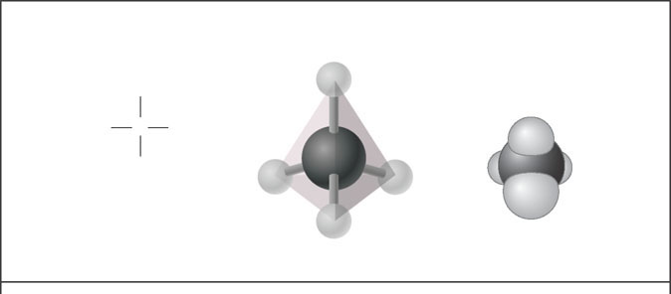
Carbon
0
A carbon atom can form four covalent bonds
Allowing it to build large and diverse organic compounds
Structural formula
Ball-and-stick model
Space-filling model
H
H
H
C
H
H
C
H
H
Methane
H
Figure 3.1A
The 4 single bonds of carbon point to the corners of a tetrahedron.

Slide 4
Macromolecules
4 Types:
Carbohydrates, Lipids, Proteins, Nucleic Acids

Slide 5
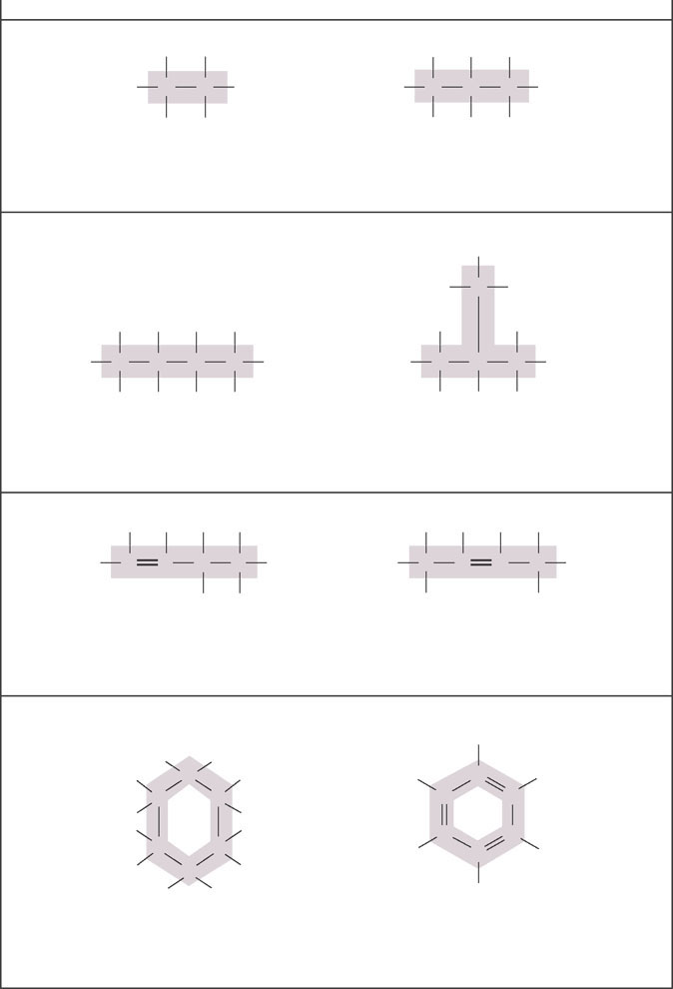
H
H
H
H
H
0
H
C
C
H
H
C
C
C
H
H
H
H
H
H
Ethane
Propane
Carbon skeletons vary in length.
H
H
C
H
H
H
H
H
H
H
H
C
C
C
C
H
H
C
C
C
H
H
H
H
H
H
H
H
Butane
Isobutane
Skeletons may be unbranched or branched.
H
H
H
H
H
H
H
H
C
C
H
C
C
C
H
H
C
C
H
C
H
H
H
H
1-Butene
2-Butene
Skeletons may have double bonds, which can vary in location.
H
H
H
H
C
H
H
C
H
H
C
C
C
C
H
H
C
C
C
H
H
C
H
H
C
H
C
H
H
H
Figure 3.1A
Cyclohexane
Benzene
Skeletons may be arranged in rings.

Slide 6
Carbohydrate
Contain C, H, and O
2:1 ratio(H:O)
Energy Source
Functions as building materials for biological construction
Ends in -ose

Slide 7
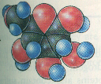
CARBOHYDRATE

Slide 8
Monosaccharide
Single sugar
Glucose (C₆H₁₂O₆) And contains hydroxyl groups and a carbonyl group
Fructose: 6 C
Ribose: 5 C

Slide 9
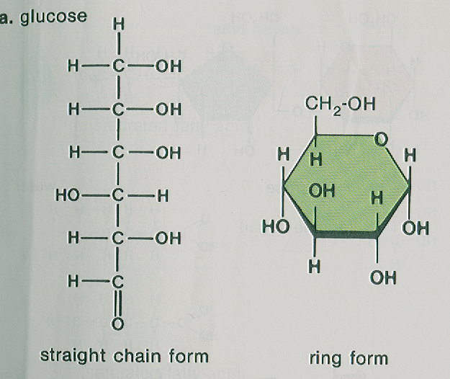

Slide 10
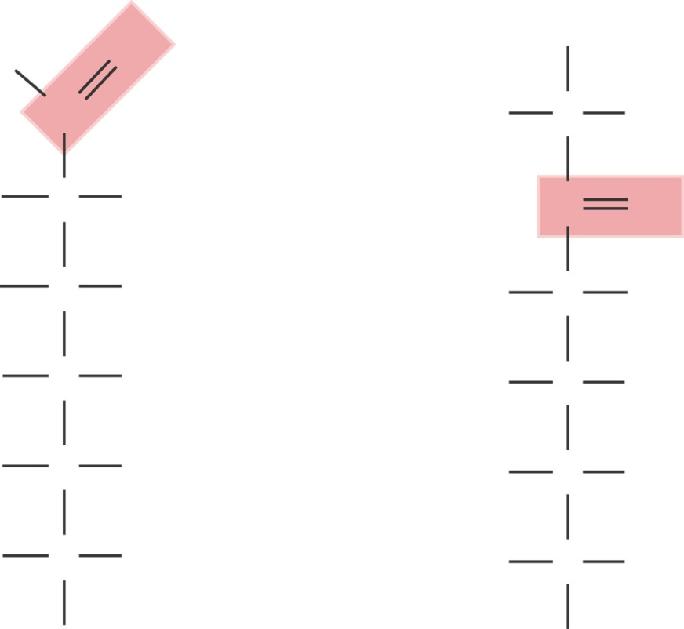
The monosaccharides glucose and fructose are isomers
contain the same atoms but in different arrangements
0
O
H
H
C
H
C
OH
H
C
OH
C
O
HO
C
H
HO
C
H
H
C
OH
H
C
OH
H
C
OH
H
C
OH
H
C
OH
H
C
OH
Figure 3.4B
H
H
Glucose
Fructose

Slide 11
Disaccharide
2 monosaccharides bonded together
C₁₂H₂₂O₁₁
Sucrose, Lactose, Maltose
Sucrose = glucose + fructose
Lactose = glucose + galactose
Maltose = glucose + glucose

Slide 12
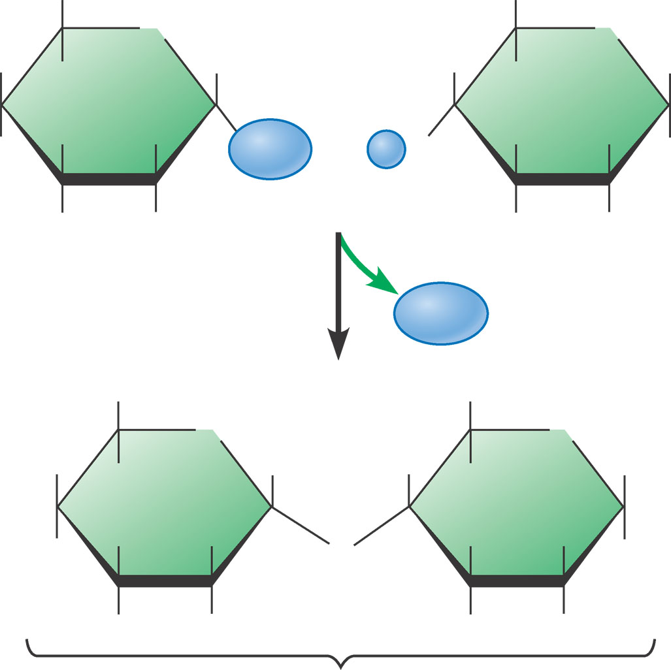
CH₂OH
CH₂OH
O
O
H
H
H
H
H
H
HO
OH
H
OH
H
O
OH
H
OH
H
OH
H
OH
Glucose
Glucose
H₂O
CH₂OH
CH₂OH
O
H
H
O
H
H
H
H
HO
OH
H
O
OH
H
OH
H
OH
H
OH
Maltose

Slide 13
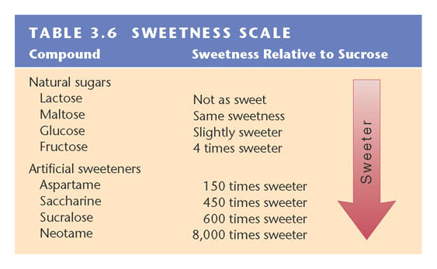
0
Table 3.6

Slide 14
Polysaccharide
Several glucose molecules bonded together
Starch, Cellulose
Starch - Animals can readily digest because of alpha bonds
Cellulose – Found in cell walls and wood; we cannot digest because of beta bonds

Slide 15
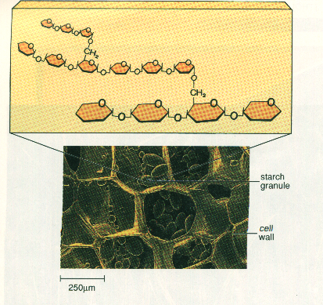

Slide 16
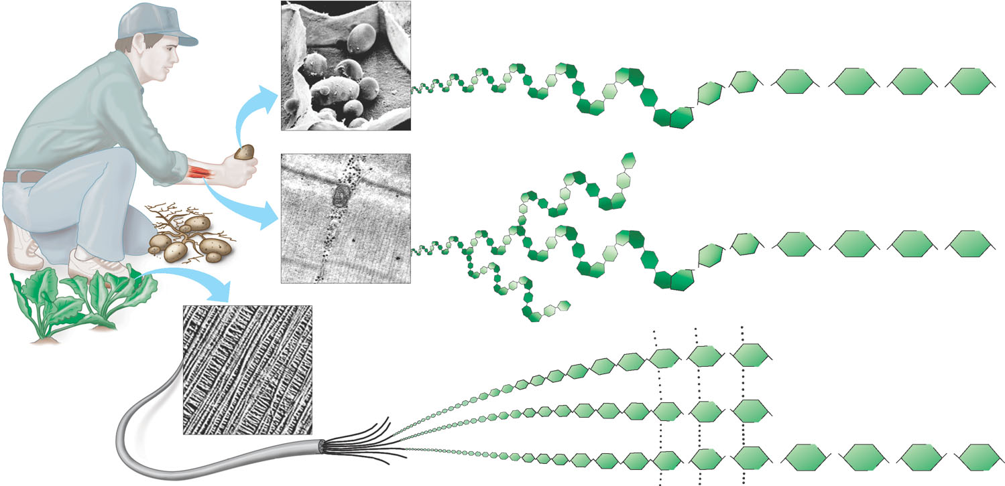
Glucose monomer
STARCH
Starch granules in potato tuber cells
O
O
O
O
O
O
O
O
O
O
O
Glycogen granules in muscle tissue
GLYCOGEN
O
O
O
O
O
O
O
O
O
O
O
O
O
Cellulose fibrils in a plant cell wall
CELLULOSE
O
O
OH
Cellulose molecules
O
O
O
O
O
O
OH
O
O
O
O
O
O
O
O
O
O
O
O
O
O
O

Slide 17
Chitin
Major component of exoskeleton of arthropods
Polymer of N containing sugar

Slide 18
Glycogen
Animal Starch
Human liver and muscles store carbohydrates in this form
Contain enough energy to fuel 30 minutes of strenuous energy

Slide 19
Lipid
Fats, oils, phospholipids, steroids, waxes
Long term storage for energy and carbon
Contain C, H, O (no ratio exists)
Have an inability to dissolve in water
Made up of fatty acids and gylcerol

Slide 20
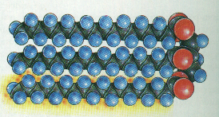
Saturated Fatty Acid

Slide 21
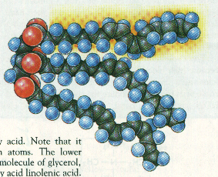
Unsaturated Fatty Acid

Slide 22
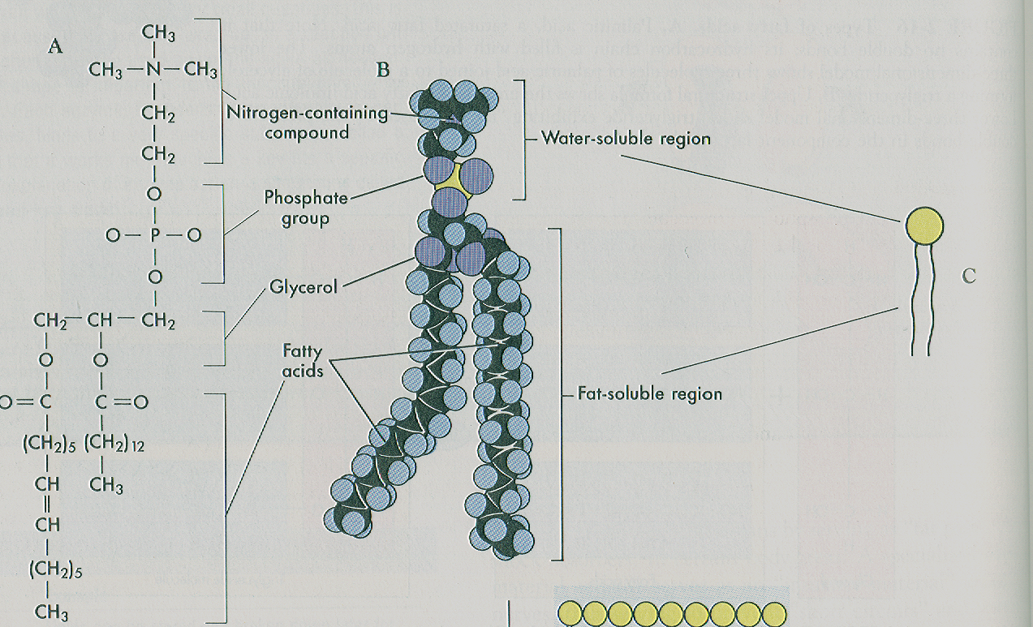

Slide 23
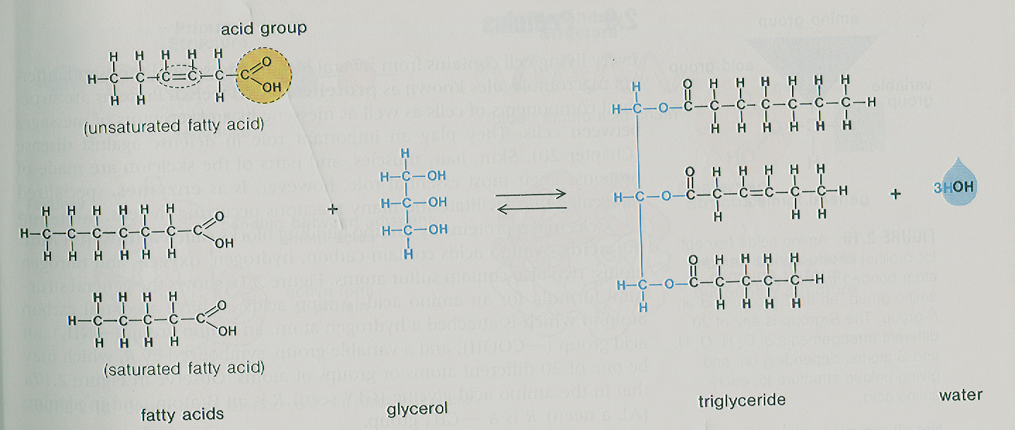

Slide 24
Lipids produced by animals: Solid
Lipids produced by plants: Liquid
Lipids produced by plants and animals: Wax

Slide 25
Fats
3 fatty acids and glycerol
Glycerol – 3 C chain
Fatty Acid: 16 – 18 C atoms

Slide 26
Saturated Fatty Acids
C - C
Solid at room temperature
Butter, lard

Slide 27
Unsaturated Fatty Acids
C = C
Oils at room temperature
Olive, Corn, and Sunflower Oil

Slide 28
Phospholipids
2 fatty acids, phosphate group, glycerol
Forms cellular membranes
P group end is soluble in water
Fatty acid tail is hydrophobic

Slide 29
Glyceride
Energy source
Insulation
Physical protection
Stored in fat deposits
Must be broken down to be used

Slide 30
Prostaglandin
Fatty acids that have their C atoms joined in a ring
Cells release these to coordinate or direct local cellular activities
Pain
Labor contraction
Prevent stomach ulcer

Slide 31
Steroids
4 ringed skeleton
Cholesterol
In cell membrane
Hormones
Not found in plant cells

Slide 32
Wax
Contains many more fatty acids linked together to longer chain backbone
Waterproof covering of plants and feathers of bird
Produces honeycomb
Found in human ear canal

Slide 33
Proteins
Structural components of cells
Transports particles in and out of cells
Plays a role in defense against disease
Make up skin, hair, and muscles

Slide 34
Proteins
Messengers and receptors
Acts as enzymes
Made up of amino acids
Contains C, H, O, N

Slide 35
4 Categories
Polar Charged
R groups are fully charged
Polar Uncharged
Have partial + or - charge
Non Polar
Hydrophobic
Very Small R Groups

Slide 36
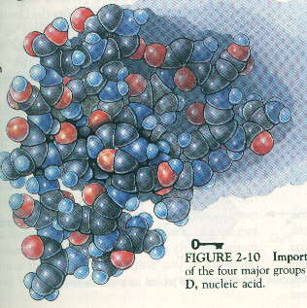
PROTEIN

Slide 37
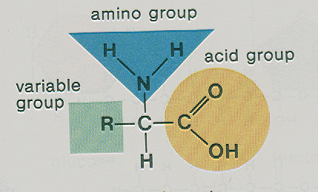

Slide 38
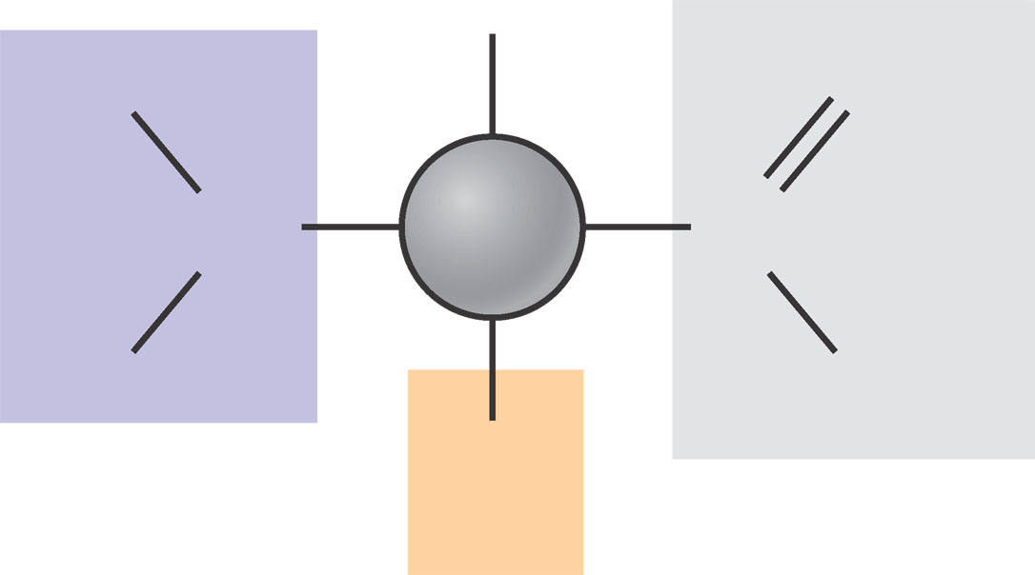
Figure 3.12A General structure of an amino acid
H
O
H
N
C
C
H
OH
R
Amino
group
Carboxyl (acid)
group

Slide 39
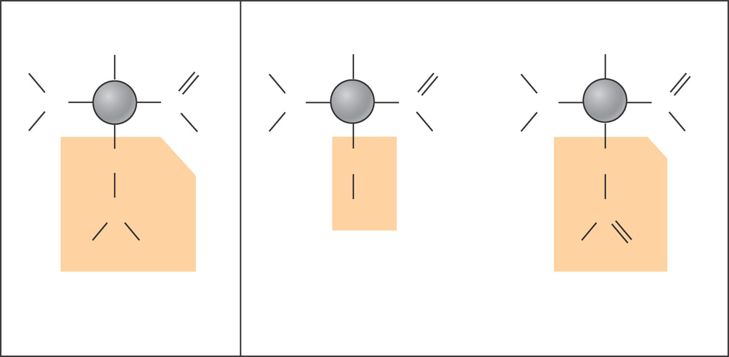
Figure 3.12B Examples of amino acids
H
H
H
H
O
H
O
H
O
N
C
C
N
C
C
N
C
C
H
OH
H
OH
H
OH
CH₂
CH₂
CH₂
CH
OH
C
CH₃
CH₃
OH
O
Leucine (Leu)
Serine (Ser)
Aspartic acid (Asp)
Hydrophobic
Hydrophilic

Slide 40
Peptide
Amino Acids bonded to one another
Dipeptide, Polypeptide
Peptide Bond: linkages formed by joining the carboxyl group of 1 amino acid to the amino group of an amino acid of its neighbor

Slide 41
Peptide bond formation
Carboxyl
group
Amino
group
Peptide
bond
H
H
Dehydration
reaction
H
O
H
H
O
H
O
H
O
N
C
C
+
N
C
C
N
C
C
N
C
C
H
OH
H
OH
H
R
H
R
OH
R
R
H₂O
Amino acid
Amino acid
Dipeptide

Slide 42
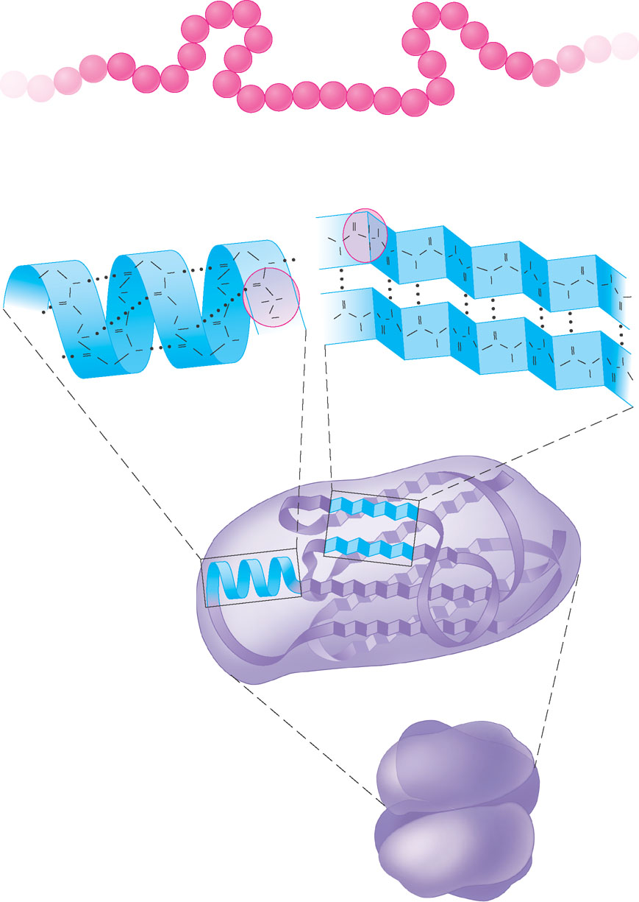
Levels of Protein Structure
Leu
Pro
Met
Asn
Val
Primary structure
Cys
Val
Ile
Ala
Arg
Gly
Glu
Lys
Ala
Val
His
Phe
Gly
Thr
Ser
Lys
Val
Ala
Val
Pro
Val
Leu
Asp
Arg
Gly
Ser
Amino acids
Hydrogen
bond
O
H
C
C
H
O
C
C
N
N
H
O
C
R
C
C
C
N
C
H
H
N
H
O
C
C
N
O
C
C
C
H
O
N
C
H
C
N
N
H
O
N
H
C
H
C
C
N
O
O
C
N
C
N
C
H
N
H
O
C
R
O
C
C
C
O
Secondary structure
O
C
C
H
C
H
O
H
N
H
N
O
C
C
C
C
C
N
H
O
C
O
H
C
N
C
O
H
C
N
C
H
N
H
H
O
N
O
C
N
C
N
H
O
C
C
C
N
H
C
N
H
O
C
O
C
C
C
H
C
N
C
O
H
N
Alpha helix
Pleated sheet
O
C
Tertiary structure
Polypeptide
(single subunit
of transthyretin)
Quaternary structure
Transthyretin, with
four identical
Polypeptide subunits

Slide 43
Protein Structures
1⁰ Structure : Sequence of Amino acids
2⁰ Structure: Alpha helix or Beta Pleated sheets
3⁰ Structure: Polypeptide
4⁰ Structure: Joining of multiple polypeptides

Slide 44
0
Primary Structure
A protein’s primary structure
Is the sequence of amino acids forming its polypeptide chains
Levels of Protein Structure
Leu
Met
Asn
Val
Pro
Ala
Val
Ile
Cys
Val
Arg
Glu
Lys
Ala
His
Phe
Gly
Val
Primary structure
Thr
Ser
Lys
Val
Gly
Ala
Val
Pro
Leu
Asp
Arg
Gly
Ser
Amino acids
Figure 3.14A

Slide 45
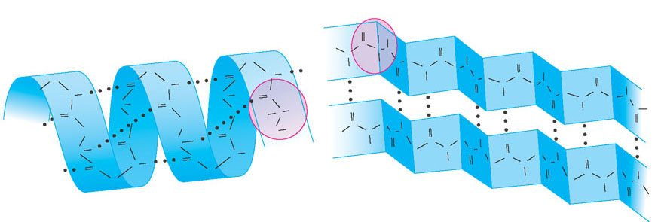
Secondary structure
Is the coiling or folding of the chain, stabilized by hydrogen bonding
0
Amino acids
Hydrogen
bond
O
H
C
C
H
O
C
C
N
N
H
O
C
R
C
C
C
N
C
C
O
C
N
H
H
N
H
O
C
C
C
N
H
O
C
N
C
H
N
H
O
N
H
C
H
N
C
C
O
O
C
N
C
N
H
O
C
O
H
N
O
C
C
C
C
H
C
R
H
O
H
C
N
H
C
N
O
O
C
C
C
Secondary structure
O
C
N
H
O
C
C
N
C
C
H
O
N
H
H
H
C
N
C
H
C
N
O
N
C
O
H
O
C
N
C
O
C
N
C
H
O
C
N
C
N
C
H
C
H
C
C
O
H
N
Alpha helix
Pleated sheet
O
C
Figure 3.14B

Slide 46
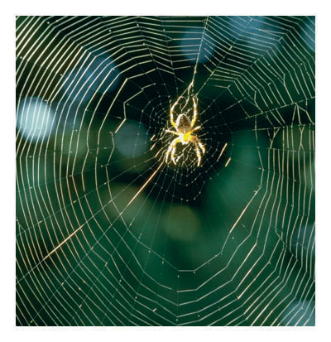
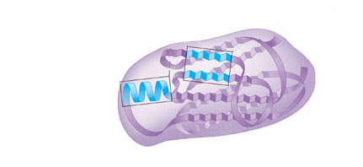
0
Tertiary Structure
Is the overall three-dimensional shape of a polypeptide
Tertiary structure
Polypeptide
(single subunit
of transthyretin)
Figure 3.14C

Slide 47
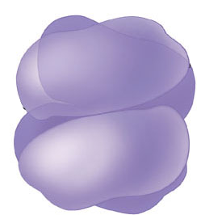
0
Quaternary Structure
Results from the association of two or more polypeptide chains
Polypeptide
chain
Quaternary structure
Transthyretin, with
four identical
polypeptide subunits
Figure 3.14D
Collagen

Slide 48
Nucleic Acid
DNA, RNA
Sugar, Phosphate, Base
Nucleotide

Slide 49
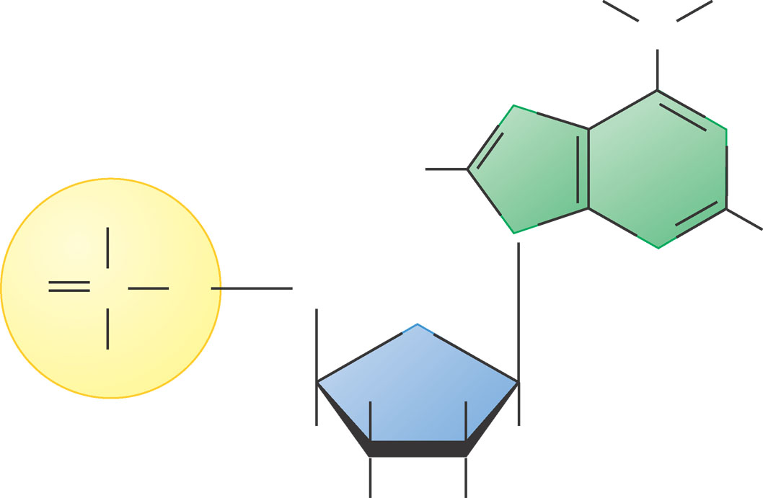
The monomers of nucleic acids are nucleotides
Composed of a sugar, phosphate, and nitrogenous base
0
H
H
N
N
N
H
OH
N
N
H
O
P
O
CH₂
Nitrogenous
base (A)
O
O⁻
H
H
Phosphate
group
H
H
OH
H
Figure 3.16A
Sugar

Slide 50
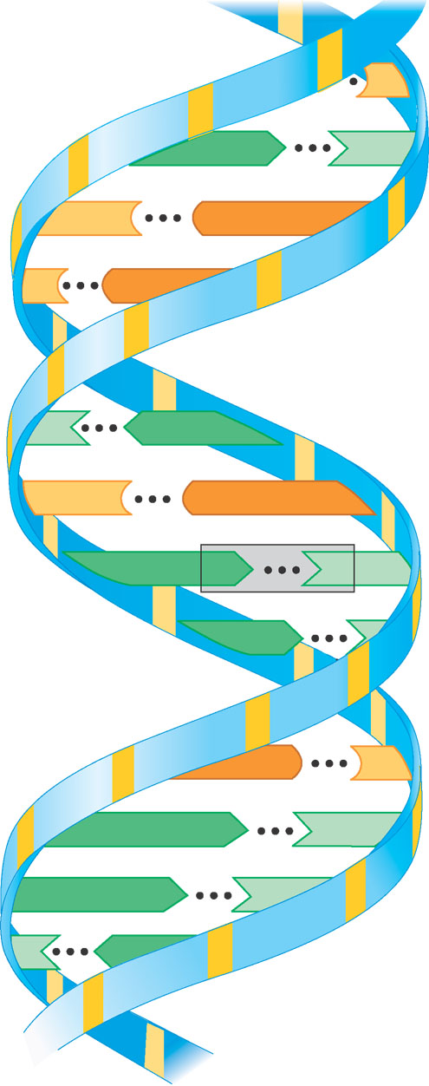
0
C
A
T
C
G
C
G
T
A
C
G
A
T
Base
pair
A
T
G
C
A
T
A
T
T
A
Figure 3.16C

Slide 51
Building Blocks of Organic Compounds
Carbohydrates: Glucose
Lipids: Fatty Acids and Glycerol
Proteins: Amino Acids
Nucleic Acids: Nucleotides

