Slide 1
Cell Cycle

Slide 4
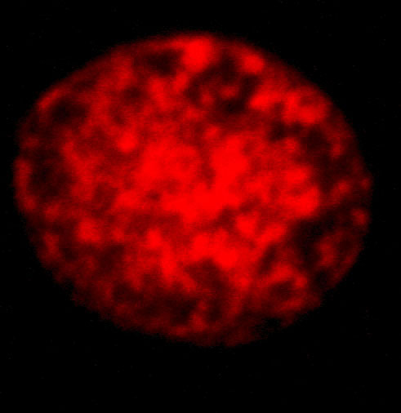
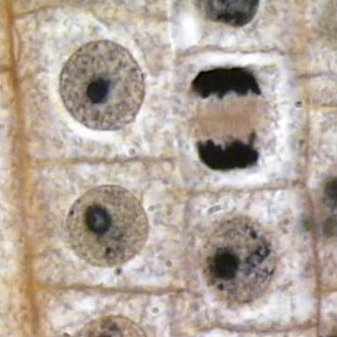
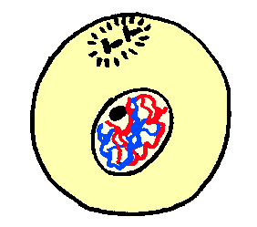
Interphase

Slide 5
Mitosis
Prophase
Metaphase
Anaphase
Telophase
Cytokinesis

Slide 6
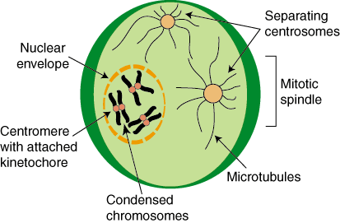
Prophase

Slide 7
Metaphase

Slide 8
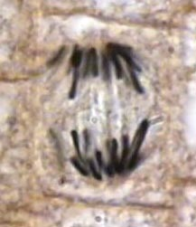
Anaphase

Slide 9
Telophase

Slide 10
Cytokinesis
Division of Cytoplasm
Results in 2 cells that are identical

Slide 13
Meiosis

Slide 14
Gametes
Sperm
Egg

Slide 15
Diploid
Haploid

Slide 17
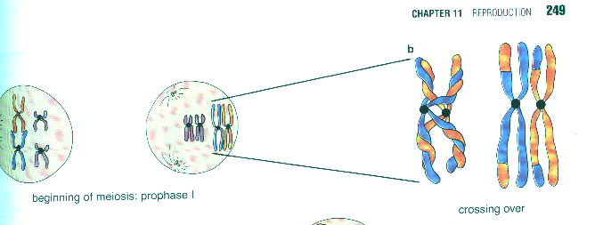

Slide 18
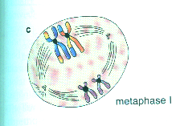

Slide 19
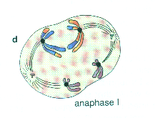

Slide 20
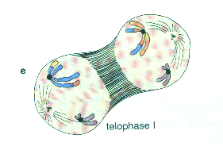

Slide 22
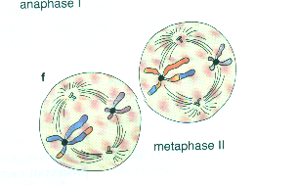

Slide 23
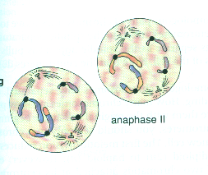

Slide 24
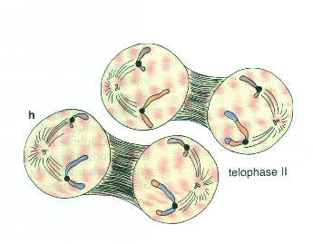

Slide 25
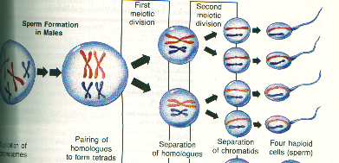
Formation of Sperm

Slide 26
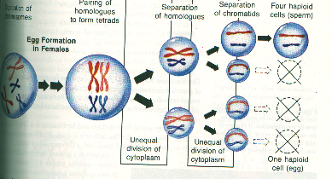
Formation of an Egg

