Slide 1
Biotechnology

Slide 2
Biotechnology
Use of organisms or their components to make useful products

Slide 3
Genetic Engineering
The direct manipulation of genes for practical purposes

Slide 4
Restriction Enzymes
Molecular scalpels used to cut DNA in a precise and predictable manner
Breaks the phosphodiester bonds that hold nucleotides together

Slide 6
Restriction Enzymes
Two Types:
Endonucleases:Cut DNA in internal locations
Exonucleases: Cut DNA at the ends

Slide 7
Restriction Enzymes Examples
EcoRI
E: genus
co: species coli
R: strain RY13
I: first endonuclease isolated
BamHI
HindIII

Slide 8
EcoR1

Slide 9
Palindrome Sites
Place where the restriction enzymes will cut the DNA
Symmetrical nucleotide sequences between the two strands of DNA
GAATTC
CTTAAG

Slide 10
Restriction Sites
The actual place in a palindrome where the DNA is cut
GAATTC → G AATTC
CTTAAG CTTAA G

Slide 13
Gel Electrophoresis
DNA is negatively charged so it travels to the positive pole of an electric current
DNA fragments sort by size in a polyacrylamide gel.

Slide 17
RFLP
Restriction Fragment Length Polymorphisms
Used in Forensics, paternity testing, and in detecting harmful diseases.

Slide 20
PCR
Polymerase Chain Reaction
DNA is copied many times in a test tube.
Process can generate 100 billion copies of DNA in 4 hours

Slide 22
Short Tandem Repeats (STR)
STR’s are locations (loci) on the chromosome that contain short sequences of 2 to 5 bases that repeat themselves in the DNA molecule.
Provides greater discrimination, requires less time, a smaller sample size, and the DNA is less susceptible to degradation.

Slide 23
Short Tandem Repeats (STR)
Each person has two STR types for TH01—one inherited from each parent.
By continuing the process with additional STRs from other genes, you can narrow down the probability of DNA belonging to only one probable person.

Slide 24
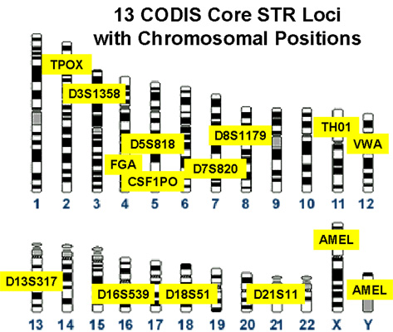

Slide 25
Short Tandem Repeats (STR) Procedure
Extract the gene TH01 from the sample. (TH01 has seven human variants with a repeating sequence of A-A-T-G)
Amplify the sample by means of PCR
Separate by electrophoresis
Examine the distance the STR migrates to determine the number of times TH01 repeats

Slide 26
Short Tandem Repeats (STR)
STR typing is visualized by peaks shown on a graph. Each represents the size of the DNA fragment.
The possible alleles are numbered for each loci.

Slide 27
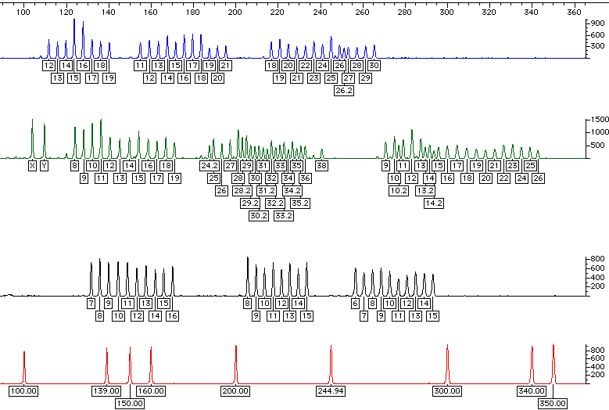
Profiler Plus Allelic Ladders
D3S1358
VWA
FGA
AMEL
D8S1179
D21S11
D18S51
D5S818
D13S317
D7S820

Slide 28
Cloning
Nuclear Transplantation: replaces the nucleus of an egg cell or a zygote with a nucleus of an adult somatic cell
Cells divides → creates blastocyst
Reproductive Cloning: If animal is a mammal, the blastocyst is implanted into uterus for further development
Therapeutic Cloning: Produce embryonic stem cells for therapeutic treatments

Slide 29
Recombinant DNA Technology
Combining genes from different sources into a single DNA molecule
Can use different species
Often uses plasmids

Slide 30
Gene Cloning
1. Plasmid is isolated
2. DNA carrying gene of interest is taken from another cell
3. The piece of DNA containing gene is inserted into a plasmid
4. Bacteria takes up plasmid through transformation
5. Bacteria reproduces; forming a clone of cells

Slide 32
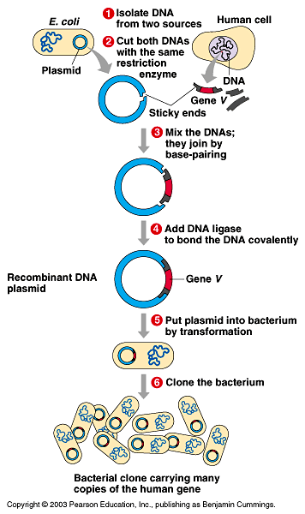

Slide 33
Recombinant DNA
DNA from two different sources are combined into the same DNA

Slide 34
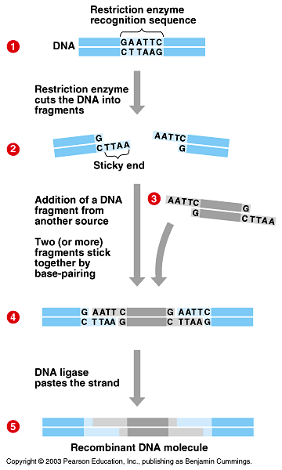

Slide 35
`

Slide 36
Products of Recombinant DNA
Products | Activity
Interferon's | Fight viral infection; boost immune system;
Interleukin 2 | Activate immune system (serious side effects) used in kidney cancer
Tumor necrosis factor | Attacks and kills cancer cells
Erythropoietin | Stimulates red blood cell production (anemia)
Beta-endorphin | Natural morphine to treat pain
Vaccines-hepatitis B | Stimulates body's immunity

Slide 37
Genetically Modified Organisms
Organisms that have acquired one or more genes by artificial means rather than by traditional breeding methods
Uses plasmids
Transgenic Organism: newly acquired gene is from a new species

Slide 39
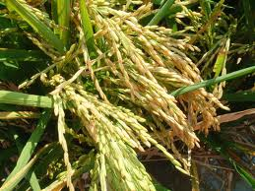
Golden Rice- GMO Foods
In rice β-carotene is present in vegetative (green) tissue but not the grain
Introduces β-carotene into the grain and can reduce vitamin A deficiencies*
*At least a quarter-billion children worldwide, but mostly in the developing world, have poor diets lacking in vitamin A. According to the World Health Organization, between 250,000 and 500,000 children go blind every year as a result, with half of those dying within 12 months.

Slide 40
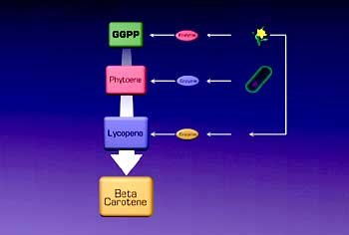

Slide 41
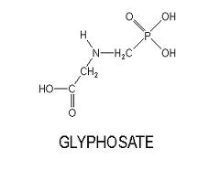
Roundup Ready soybeans & cocaine
Roundup is a glyphosate
Herbicide
Roundup ready plants can survive being sprayed
Drug lords in Columbia have created Roundup ready coca plants

Slide 42
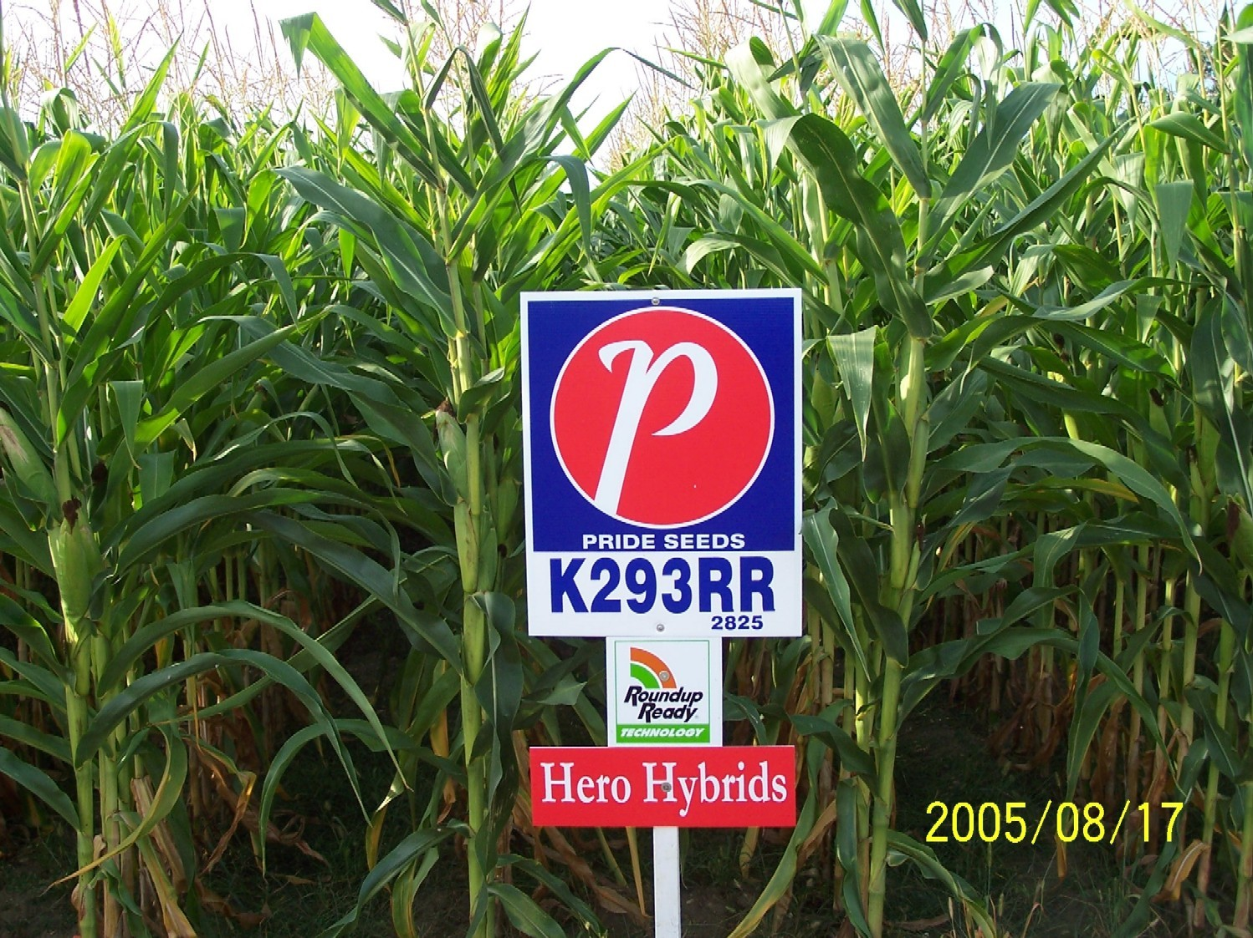

Slide 43
Knockout Mice
Genetically engineered to have genes made inoperable
By knocking out a gene you can figure out what the gene does
Used in the study of cancer, obesity, heart disease, diabetes, arthritis, substance abuse, anxiety, aging and Parkinson's disease

Slide 44
How does it work: A

Slide 46
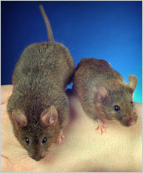
Limitations of Knockouts
~15% of gene knockouts are developmentally lethal
Knockout mouse can not survive as an adult
Some loci are very difficult to knock out

Slide 47
DNA Microarrays
DNA chips, Genome chips
Contains microscopic amounts of DNA sequences fixed into a small glass side or silicon chip
Can tell you what genes are turned on in a specific cell

Slide 48
Comparative Genomics
Compares human genome to the genome of other organisms

Slide 49
Proteomics
Study of structure, function, and interaction of cellular proteins
Proteome – entire collection of a species proteins

Slide 50
Bioinformatics
Application of computer technologies, special developed software, and statistical techniques to study biological information

